Slide 1
BMD ENG 301Quantitative Systems Physiology (Nervous System)
Lecture 10: Synaptic Transmission
2022_v2
Professor Malcolm A. MacIver

Slide 2
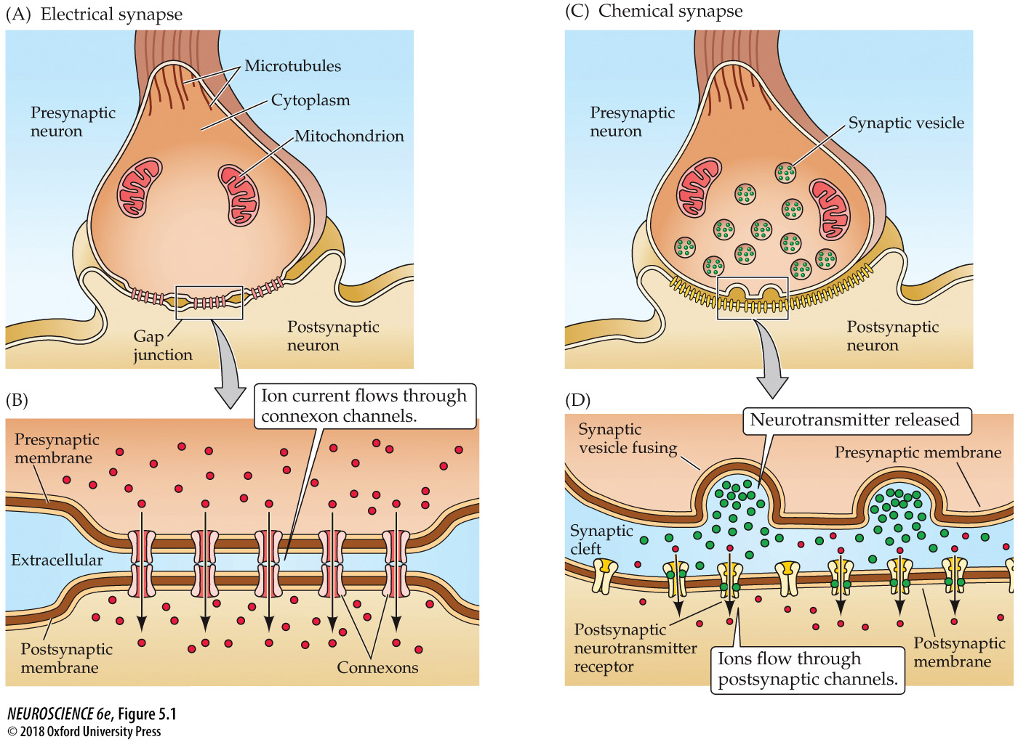
Electrical and chemical synapses differ fundamentally in their transmission mechanisms
Notes:
FIGURE 5.1 Electrical and chemical synapses differ fundamentally in their transmission mechanisms. (A) At electrical synapses, gap junctions occur between pre- and postsynaptic membranes. (B) Gap junctions contain connexon channels that permit current to flow passively from the presynaptic cell to the postsynaptic cell. (C) At chemical synapses, there is no intercellular continuity, and thus no direct flow of current from pre- to postsynaptic cell. (D) Synaptic current flows across the postsynaptic membrane only in response to the secretion of neurotransmitters, which open or close postsynaptic ion channels after binding to receptor molecules on the postsynaptic membrane.

Slide 3
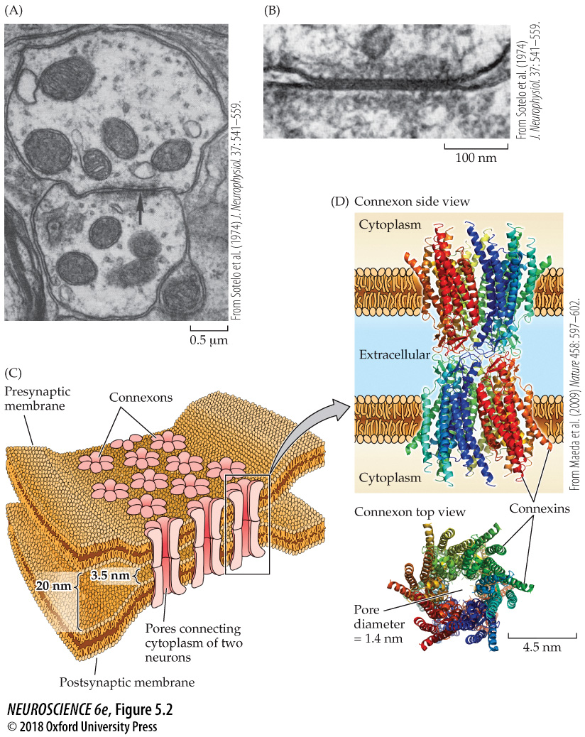
Structure of electrical synapses
Notes:
FIGURE 5.2 Structure of electrical synapses. (A) Electron micrograph of an electrical synapse (arrow) connecting two neurons within the inferior olive of a mammalian brain. (B) Higher-magnification electron micrograph of another electrical synapse, showing the gap junction structure characteristic of electrical synapses. (C) Gap junctions consist of connexons, hexameric complexes present in both the pre- and postsynaptic membranes. Channels assembled from connexons in these two membranes form pores that create electrical continuity between the two cells. (D) Crystallographic structure of connexons. Colors indicate individual connexins, integral membrane proteins that form the subunits of connexons. Side view shows the channels spanning the pre- and postsynaptic membranes; top view illustrates how six connexin subunits assemble in each membrane to form a channel with an exceptionally large pore. (A, B from Sotelo et al., 1974; D from Maeda et al., 2009.)

Slide 4
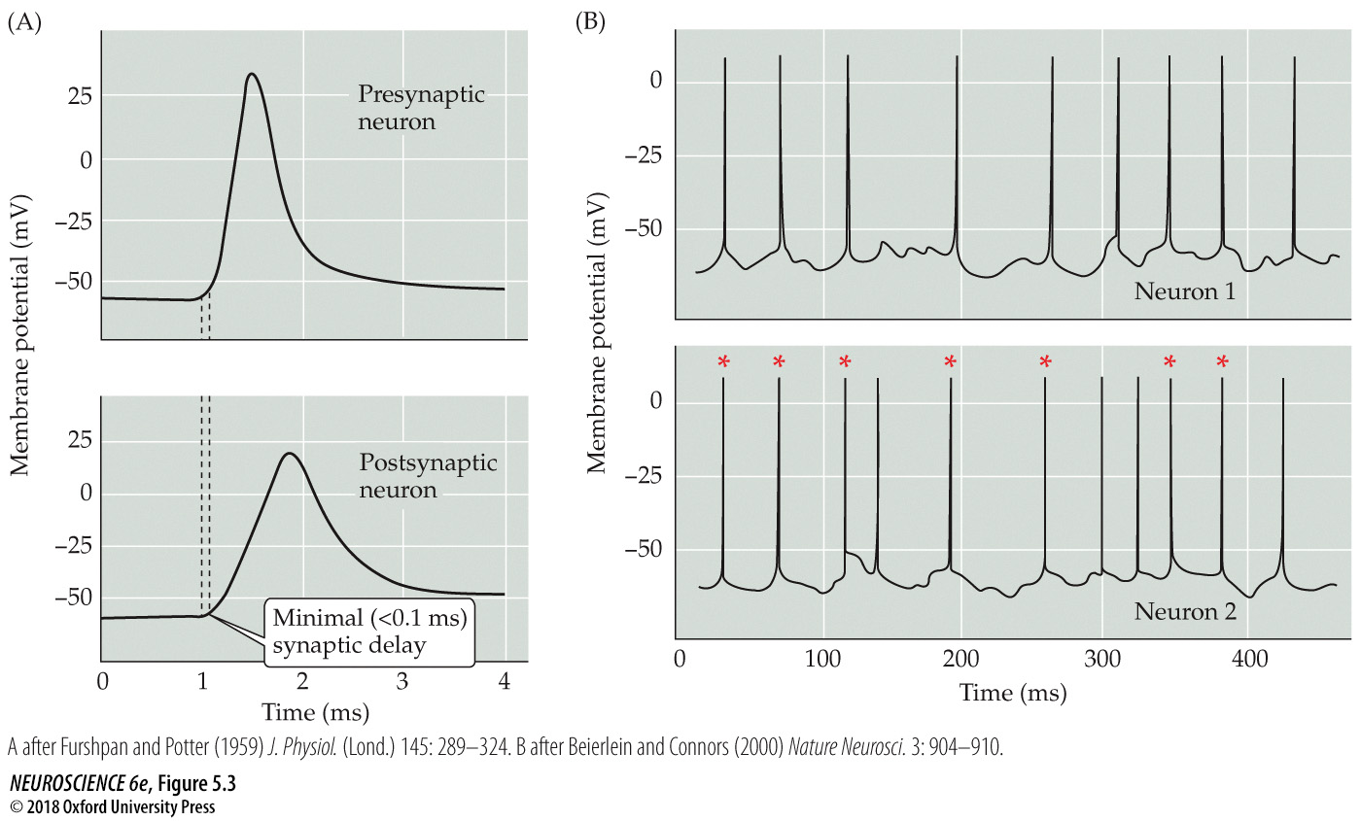
Function of gap junctions at electrical synapses
Notes:
FIGURE 5.3 Function of gap junctions at electrical synapses. (A) Rapid transmission of signals at an electrical synapse in the crayfish. An action potential in the presynaptic neuron causes the postsynaptic neuron to be depolarized within a fraction of a millisecond. (B) Electrical synapses allow synchronization of electrical activity in hippocampal interneurons. In a pair of interneurons connected by electrical synapses, generation of an action potential in one neuron often results in the synchronized firing of an action potential in another neuron (asterisks). (A after Furshpan and Potter, 1959; B after Beierlein and Connors, 2000.)

Slide 5
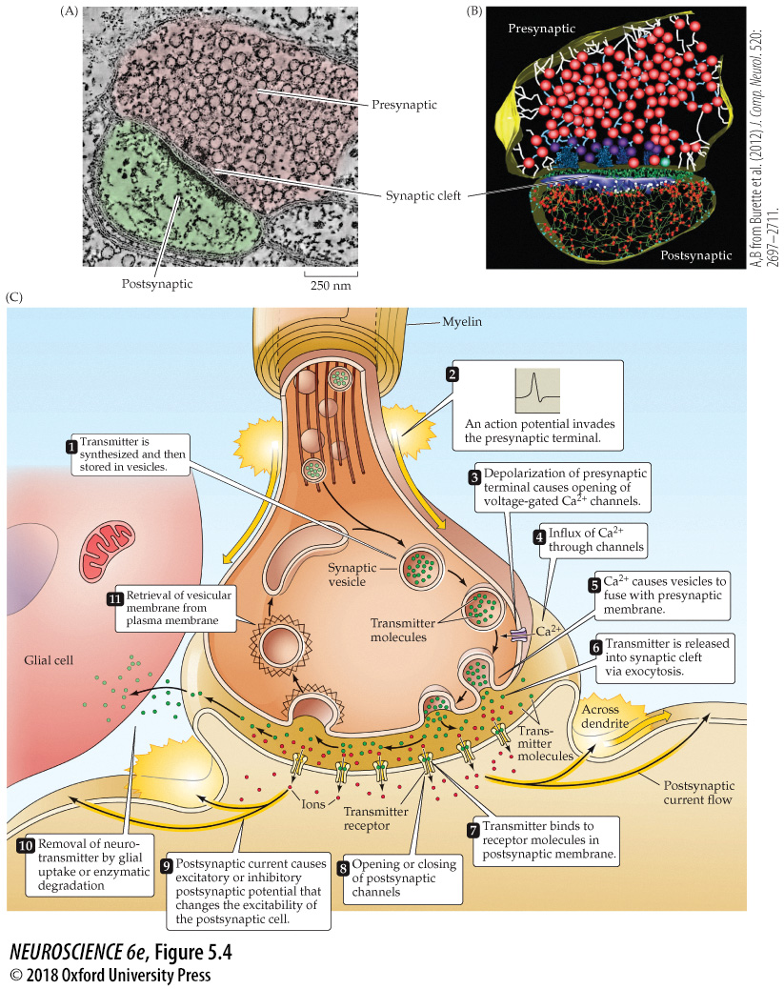
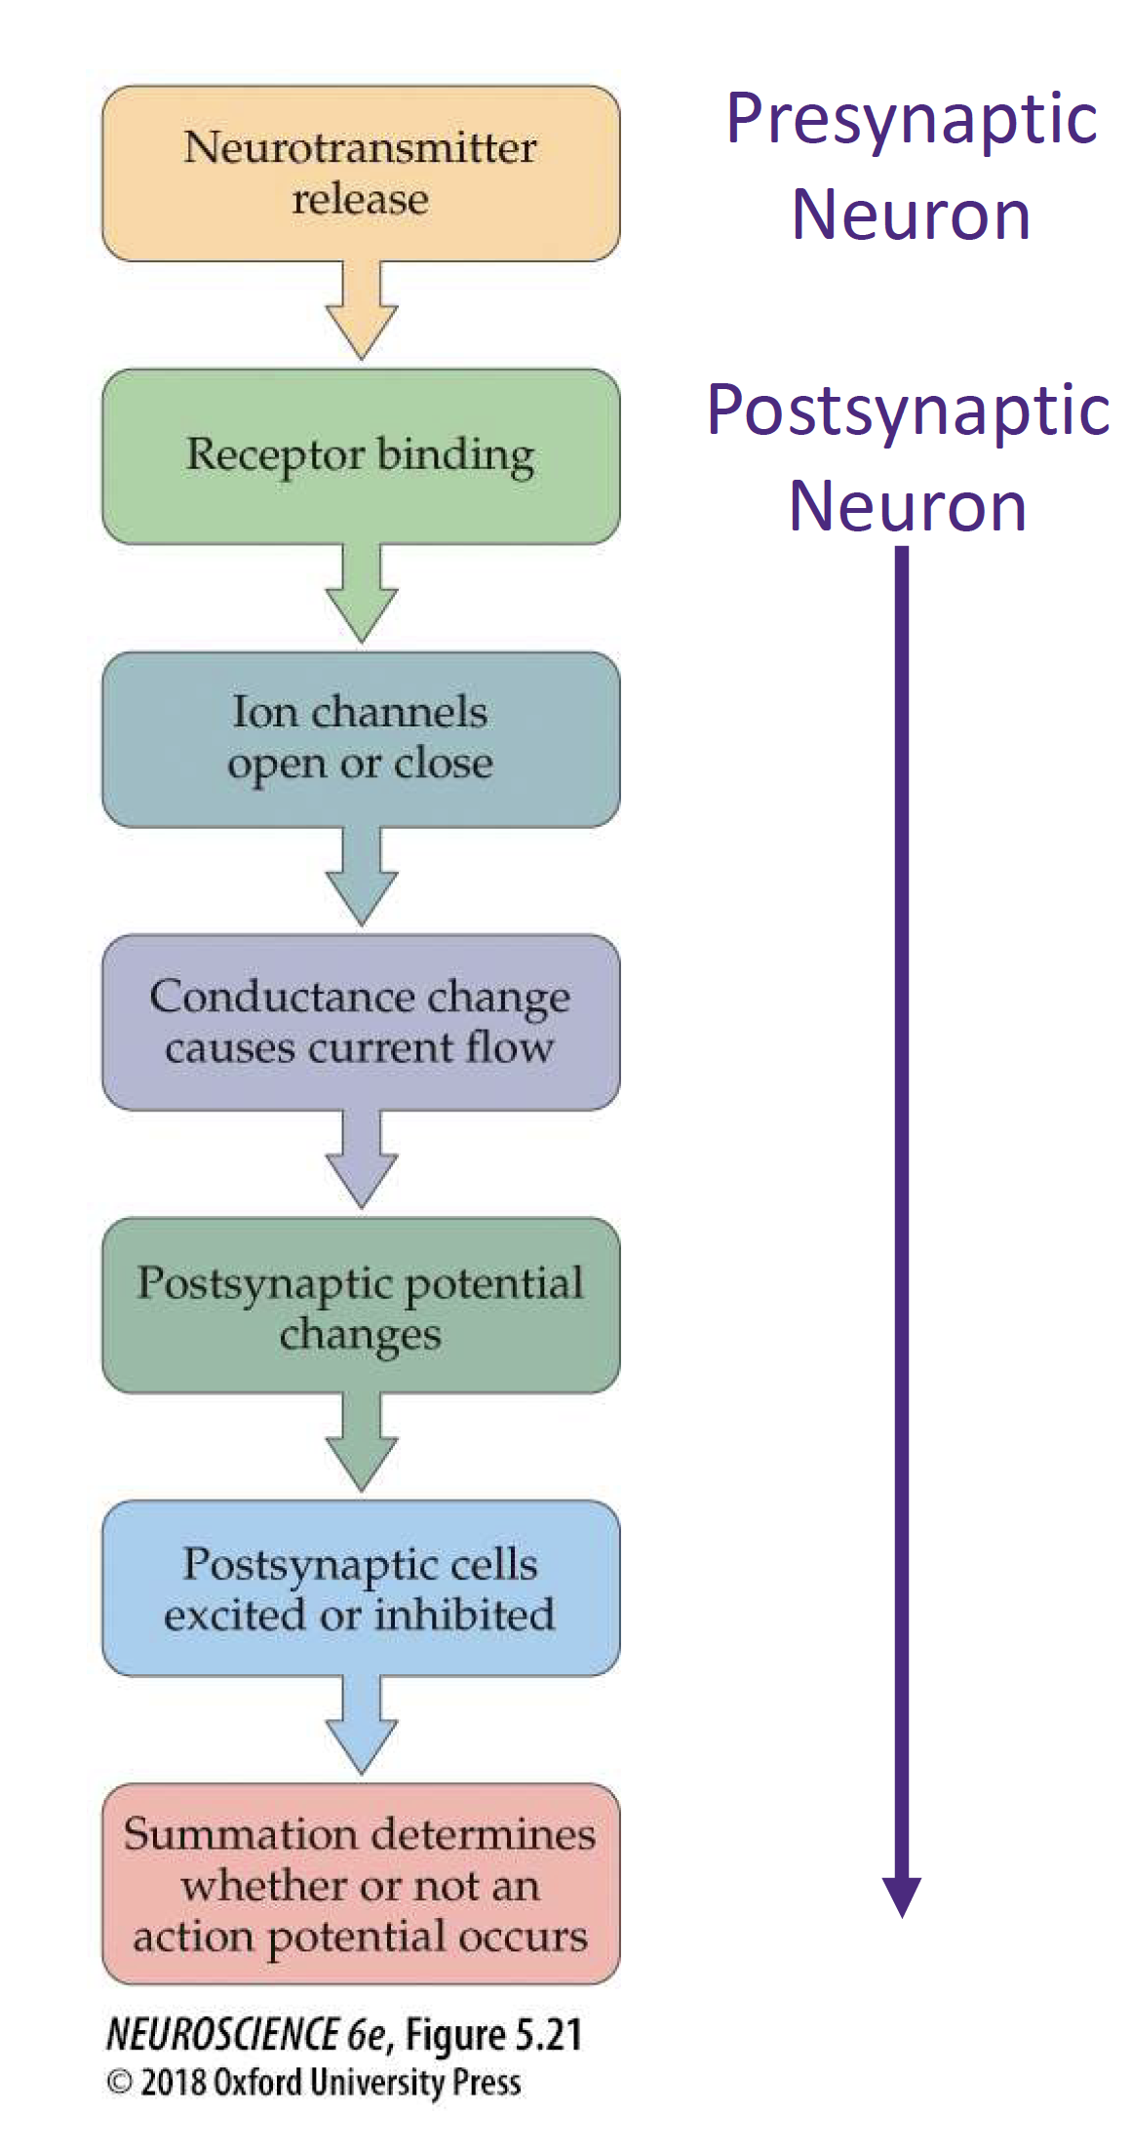
Structure and function of chemical synapses
Notes:
FIGURE 5.4 Structure and function of chemical synapses. (A) Structure of a chemical synapse in the cerebral cortex. A presynaptic terminal (pink) forms a synapse with a postsynaptic dendrite (green). (B) Three-dimensional reconstruction of the synapse shown in (A). Inside the presynaptic terminal, spheres indicate synaptic vesicles at various stages of their trafficking cycle, linear elements indicate intracellular filaments, and dark blue indicates dense projections associated with the active zone. Inside the postsynaptic neuron, the blue structure is the postsynaptic density, green structures represent filaments, red spheres indicate points where the filaments branch. Green material within the synaptic cleft indicates structures of unknown function. (C) Sequence of events involved in transmission at a typical chemical synapse. (A, B from Burette et al., 2012.)

Slide 6
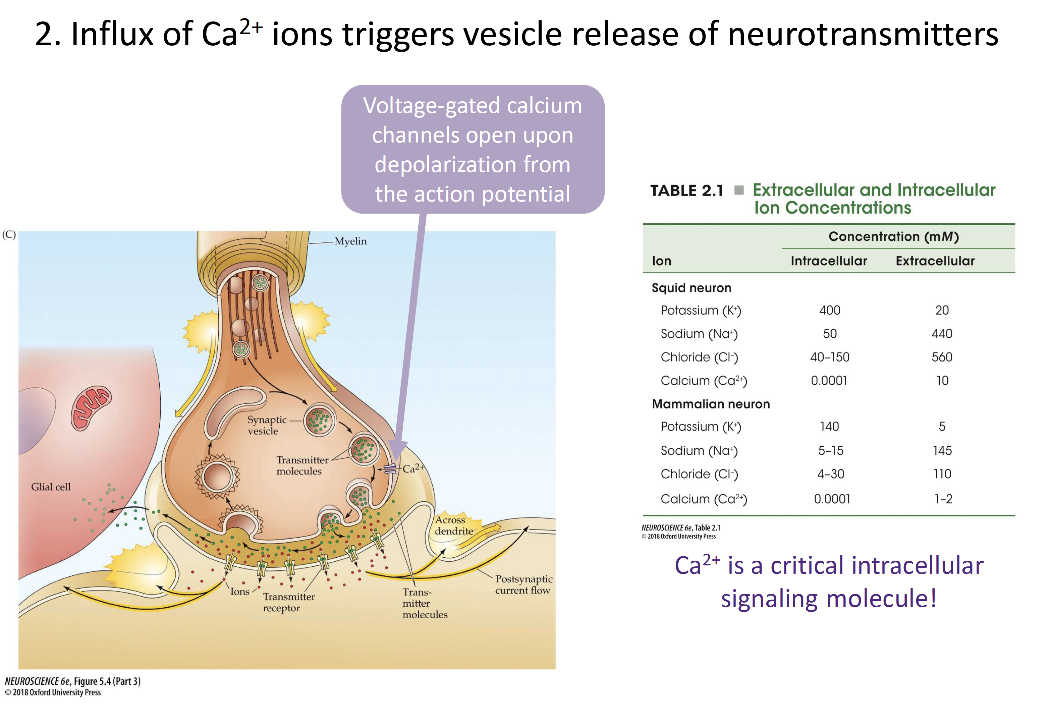

Slide 7
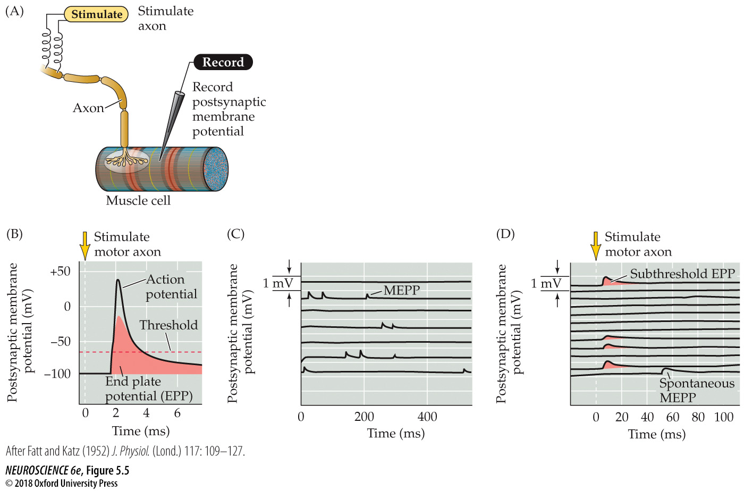
Synaptic transmission at the neuromuscular junction
Notes:
FIGURE 5.5 Synaptic transmission at the neuromuscular junction. (A) Experimental arrangement: The axon of the motor neuron innervating the muscle fiber is stimulated with an extracellular electrode, while an intracellular microelectrode is inserted into the postsynaptic muscle cell to record its electrical responses. (B) End plate potentials (shaded area) evoked by stimulation of a motor neuron are normally above threshold and therefore produce an action potential in the postsynaptic muscle cell. (C) Spontaneous miniature EPPs (MEPPs) occur in the absence of presynaptic stimulation. (D) When the neuromuscular junction is bathed in a solution that has a low concentration of Ca²⁺, stimulating the motor neuron evokes EPPs whose amplitudes are reduced to about the size of MEPPs. (After Fatt and Katz, 1952.)

Slide 8
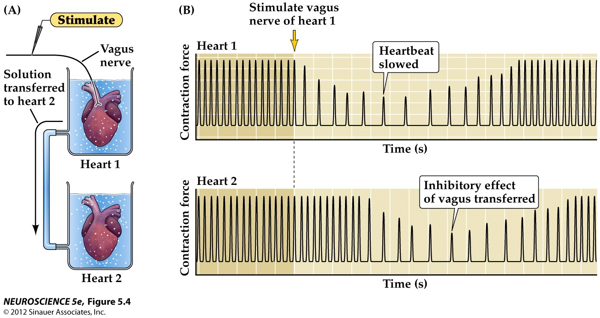
Figure 5.4 Loewi’s experiment demonstrated chemical neurotransmission

Slide 9
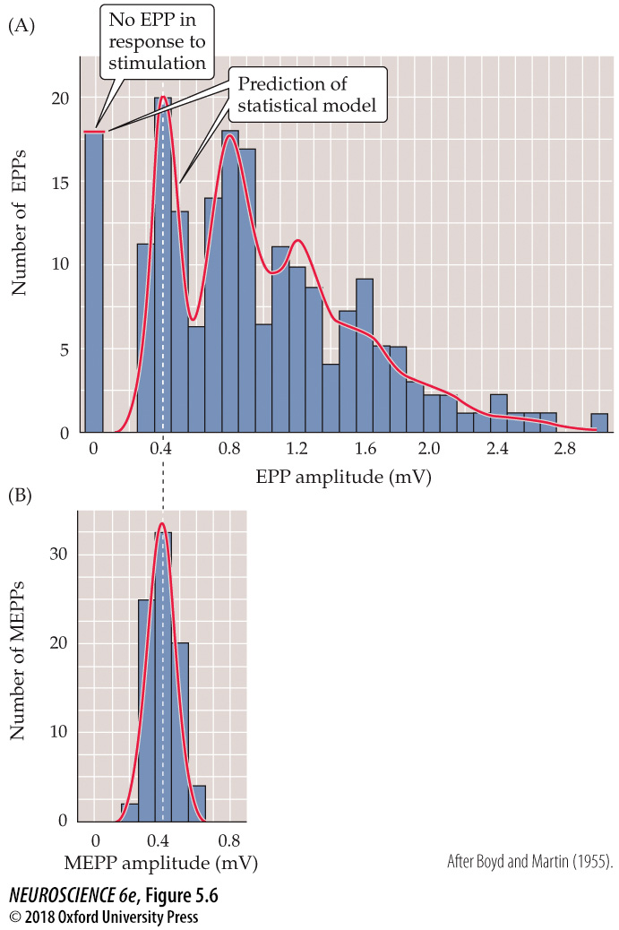
Quantized distribution of EPP amplitudes evoked in a low-Ca²⁺ solution
Notes:
FIGURE 5.6 Quantized distribution of EPP amplitudes evoked in a low-Ca²⁺ solution. Peaks of EPP amplitudes (A) tend to occur in integer multiples of the mean amplitude of MEPPs, whose amplitude distribution is shown in (B). The leftmost bar in the EPP amplitude distribution shows trials in which presynaptic stimulation failed to elicit an EPP in the muscle cell. The red curve indicates the prediction of a statistical model based on the assumption that the EPPs result from the independent release of multiple MEPP-like quanta. The observed match, including the predicted number of failures, supports this interpretation. (After Boyd and Martin, 1955.)

Slide 10
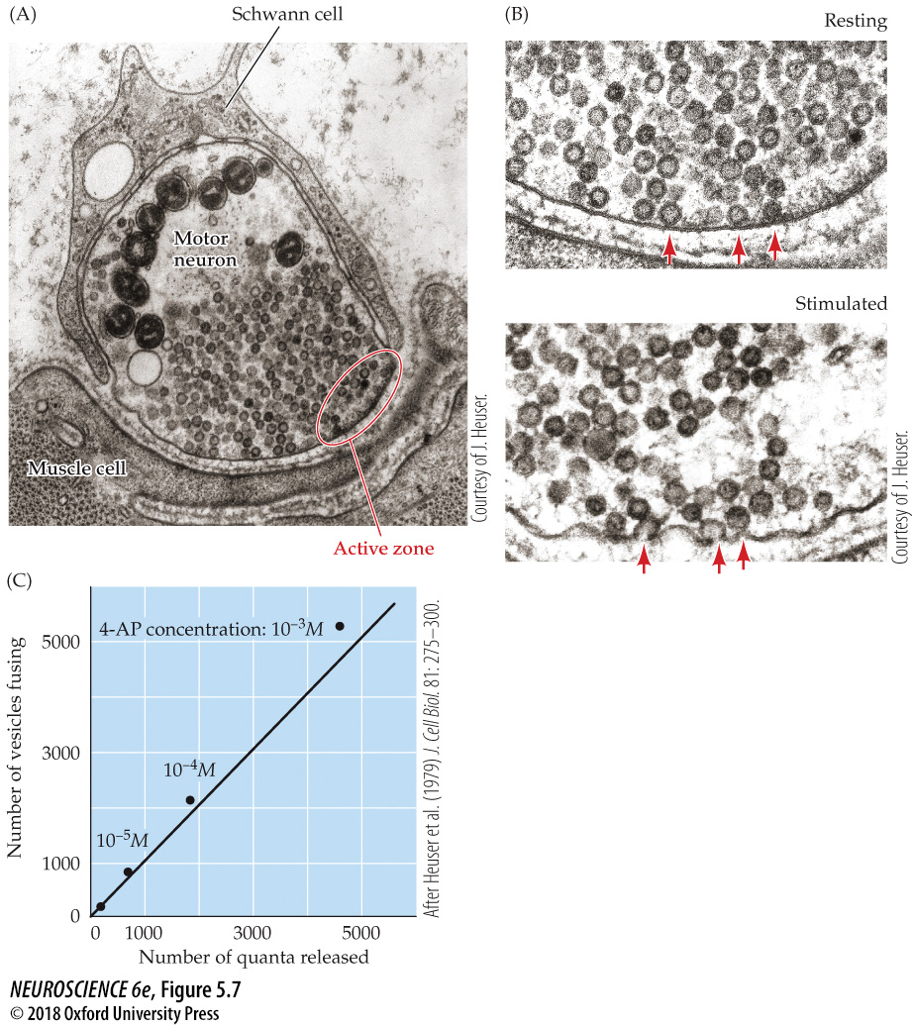
Relationship between synaptic vesicle exocytosis and quantal transmitter release
Notes:
FIGURE 5.7 Relationship between synaptic vesicle exocytosis and quantal transmitter release. (A) Electron micrograph of a frog neuromuscular synapse. This synapse includes a presynaptic motor neuron that innervates a postsynaptic muscle cell and is covered by a type of glial cell called a Schwann cell. The active zone of the presynaptic terminal is the site of synaptic vesicle exocytosis. (B) Top: Active zone of an unstimulated presynaptic terminal. While many synaptic vesicles are present, including several that are docked at the active zone (arrows), none are fusing with the presynaptic plasma membrane. Bottom: Active zone of a terminal stimulated by an action potential; stimulation causes fusion (arrows) of synaptic vesicles with the presynaptic membrane. (C) Comparison of the number of observed vesicle fusion events with the number of quanta released by a presynaptic action potential. Transmitter release was varied by using different concentrations of a drug (4-AP) that affects the duration of the presynaptic action potential, thus changing the amount of calcium that enters during the action potential. The diagonal line is the 1:1 relationship expected if each vesicle that opened released a single quantum of transmitter. (A, B courtesy of J. Heuser; C after Heuser et al., 1979.)

Slide 11
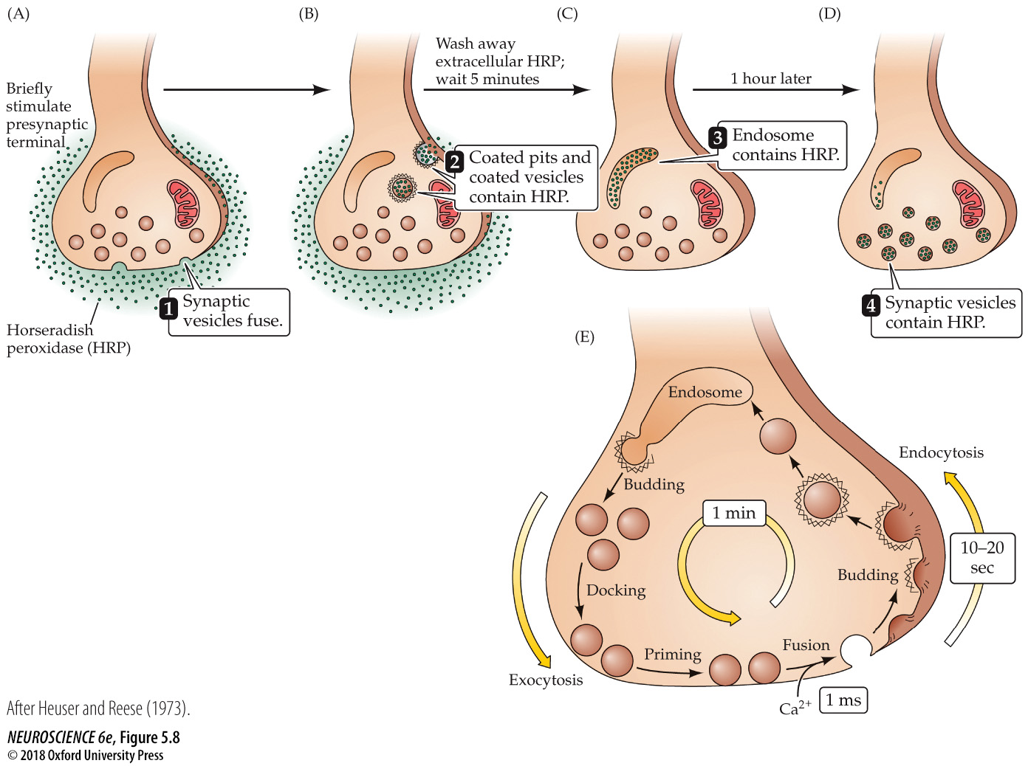
Local recycling of synaptic vesicles in presynaptic terminals
Notes:
FIGURE 5.8 Local recycling of synaptic vesicles in presynaptic terminals. (A) Horseradish peroxidase (HRP) introduced into the synaptic cleft is used to follow the fate of membrane retrieved from the presynaptic plasma membrane. Stimulation of endocytosis by presynaptic action potentials causes HRP to be taken up into the presynaptic terminals via a pathway that includes (B) coated pits and coated vesicles and (C) endosomes. (D) Eventually, the HRP is found in newly formed synaptic vesicles. (E) Interpretation of the results shown in A–D. Calcium-regulated fusion of vesicles with the presynaptic membrane is followed by endocytotic retrieval of vesicular membrane via coated vesicles and endosomes, and subsequent re-formation of new synaptic vesicles. (After Heuser and Reese, 1973.)

Slide 12
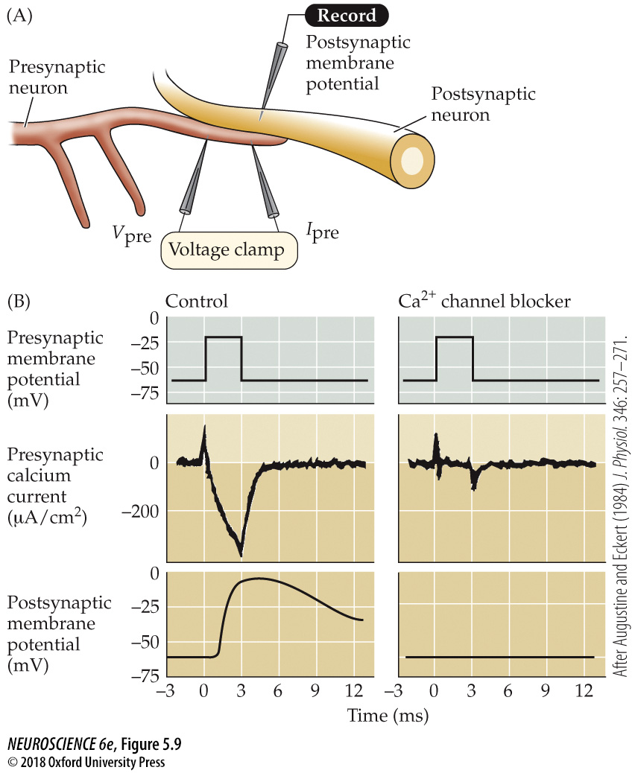
Entry of Ca²⁺ through presynaptic voltage-gated calcium channels causes transmitter release
Notes:
FIGURE 5.9 Entry of Ca²⁺ through presynaptic voltage-gated calcium channels causes transmitter release. (A) Experimental setup using an extraordinarily large synapse in the squid. The voltage clamp method detects currents flowing across the presynaptic membrane when the membrane potential is depolarized. (B) Pharmacological agents that block currents flowing through Na⁺ and K⁺ channels reveal a remaining inward current flowing through Ca²⁺ channels. This influx of calcium triggers transmitter secretion, as indicated by a change in the postsynaptic membrane potential. Treatment of the same presynaptic terminal with cadmium, a calcium channel blocker, eliminates both the presynaptic calcium current and the postsynaptic response. (After Augustine and Eckert, 1984.)

Slide 13
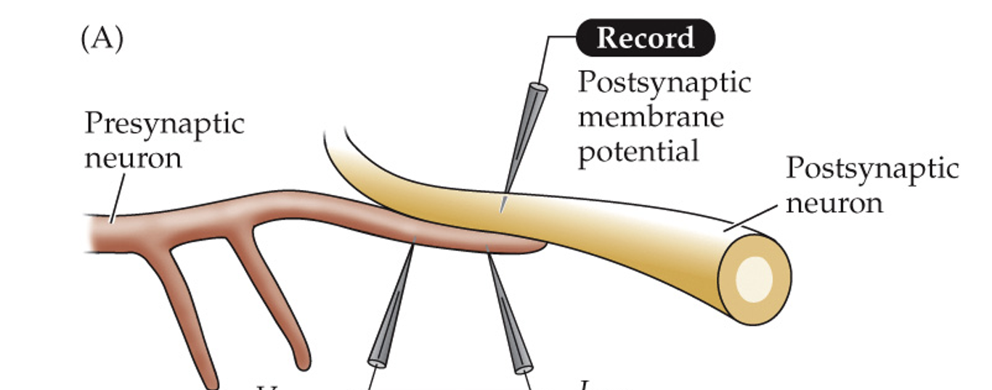
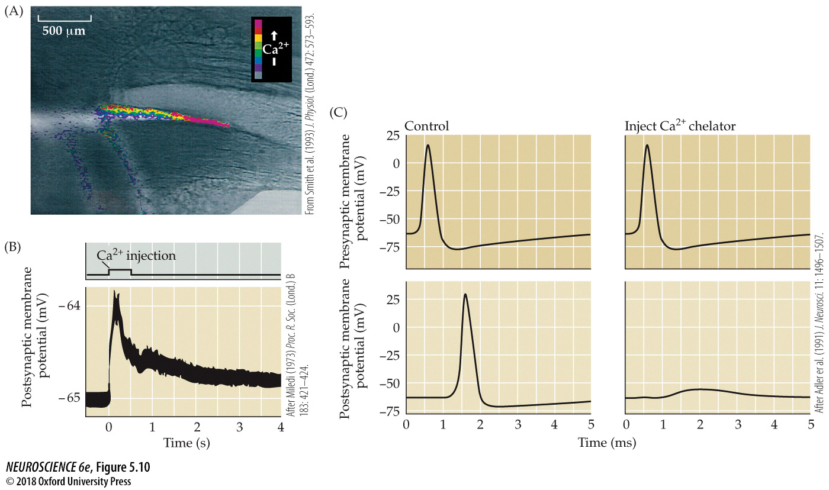
Evidence that a rise in presynaptic Ca²⁺ concentration triggers transmitter release from presynaptic terminals
Notes:
FIGURE 5.10 Evidence that a rise in presynaptic Ca²⁺ concentration triggers transmitter release from presynaptic terminals. (A) Fluorescence microscopy measurements of presynaptic Ca²⁺ concentration at the squid giant synapse (see Figure 5.9A). A train of presynaptic action potentials causes a rise in Ca²⁺ concentration, as revealed by a dye (called fura-2) that fluoresces more strongly when the Ca²⁺ concentration increases (colors). (B) Microinjection of Ca²⁺ into a squid giant presynaptic terminal triggers transmitter release, measured as a depolarization of the postsynaptic membrane potential. (C) Microinjection of BAPTA, a Ca²⁺ chelator, into a squid giant presynaptic terminal prevents transmitter release. (A from Smith et al., 1993; B after Miledi, 1973; C after Adler et al., 1991.)

Slide 14
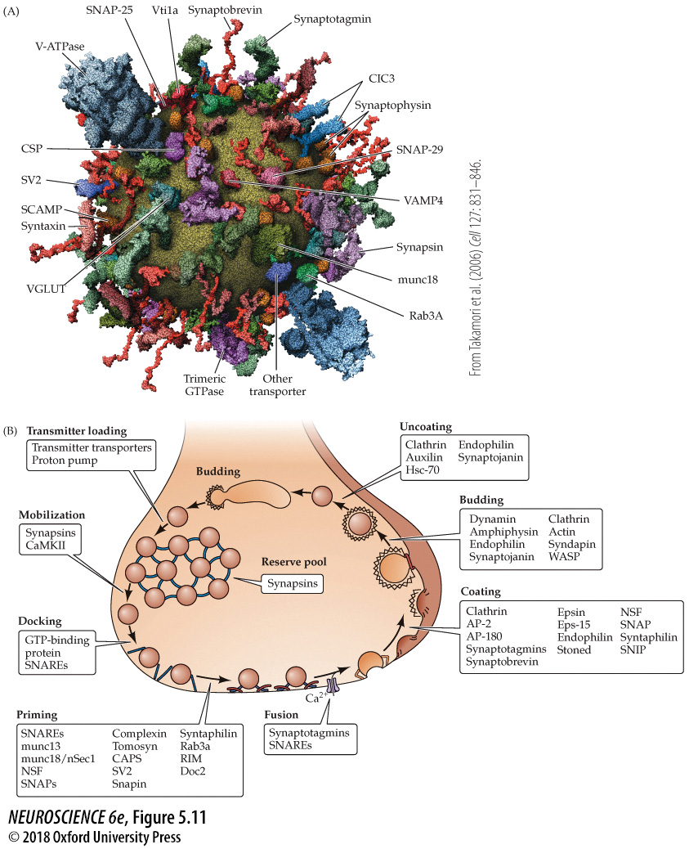
Presynaptic proteins and their roles in synaptic vesicle cycling
Notes:
FIGURE 5.11 Presynaptic proteins and their roles in synaptic vesicle cycling. (A) Model of the molecular organization of a synaptic vesicle. The cytoplasmic surface of the vesicle membrane is densely covered by proteins, only 70% of which are shown here. (B) The vesicle trafficking cycle shown in Figure 5.8E is now known to be mediated by numerous presynaptic proteins, including some of those shown in (A), with different proteins participating in different reactions. (A from Takamori et al., 2006.)

Slide 15
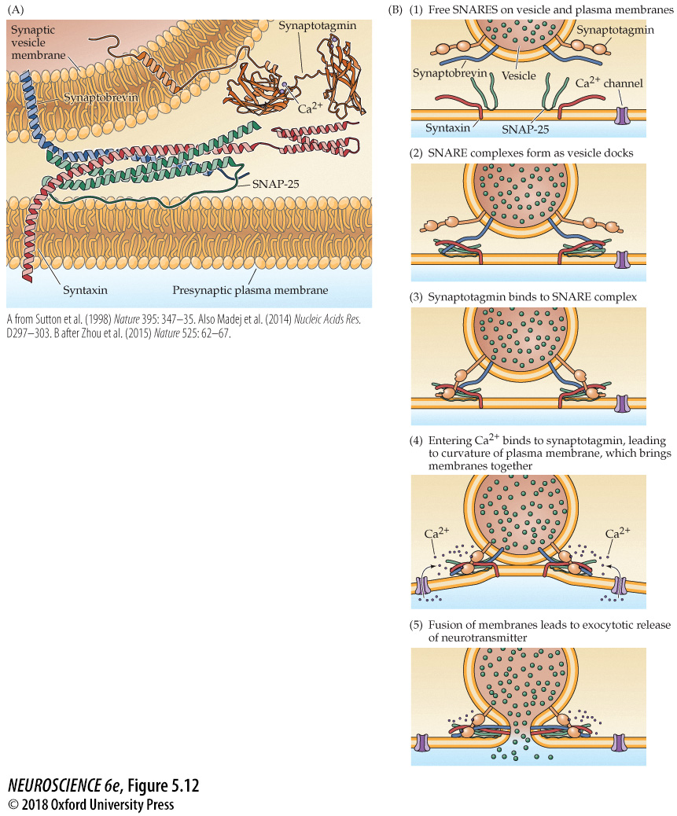
Molecular mechanisms of exocytosis during neurotransmitter release
Notes:
FIGURE 5.12 Molecular mechanisms of exocytosis during neuro-transmitter release. (A) Structure of the SNARE complex. The vesicular SNARE, synaptobrevin (blue), forms a helical complex with the plasma membrane SNAREs syntaxin (red) and SNAP-25 (green). Also shown is the structure of synaptotagmin, a vesicular Ca²⁺-binding protein, with bound Ca²⁺ indicated by spheres. (B) A model for Ca²⁺-triggered vesicle fusion. During docking of the synaptic vesicle, SNARE proteins on the vesicle and plasma membranes form a complex (as in A) that brings together the two membranes. Synaptotagmin binds to this SNARE complex. Subsequent binding of Ca²⁺ to synaptotagmin causes the cytoplasmic region of this protein to insert into the plasma membrane to produce the membrane curvature that catalyzes membrane fusion. (A from Sutton et al., 1998, and Madej et al., 2014; B after Zhou et al., 2015.)

Slide 16
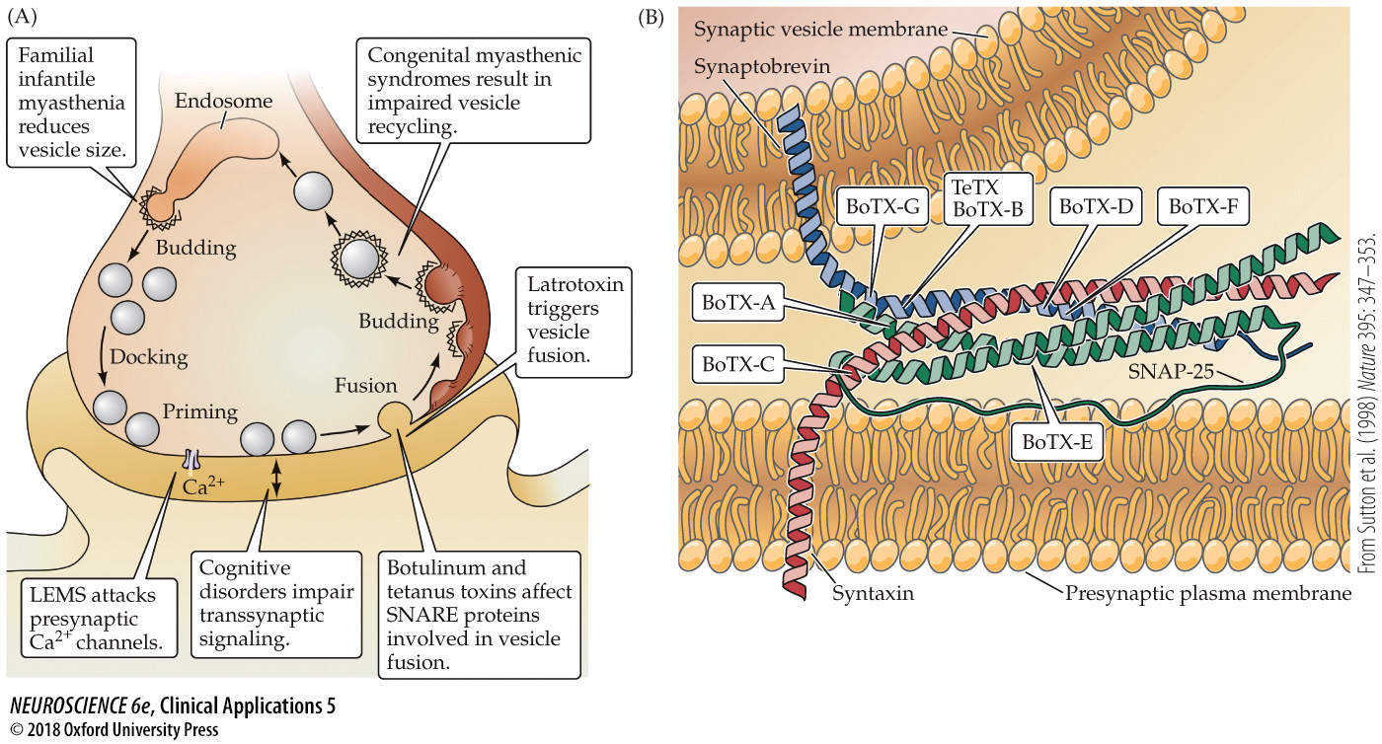
CLINICAL APPLICATIONS Disorders That Affect the Presynaptic Terminal
Notes:
CLINICAL APPLICATIONS Disorders That Affect the Presynaptic Terminal
(A) Presynaptic targets of several neurological pathologies. (B) Cleavage of SNARE proteins by clostridial toxins. Indicated are the sites of proteolysis by tetanus toxin (TeTX) and various types of botulinum toxin (BoTX). (From Sutton et al., 1998.)

Slide 17
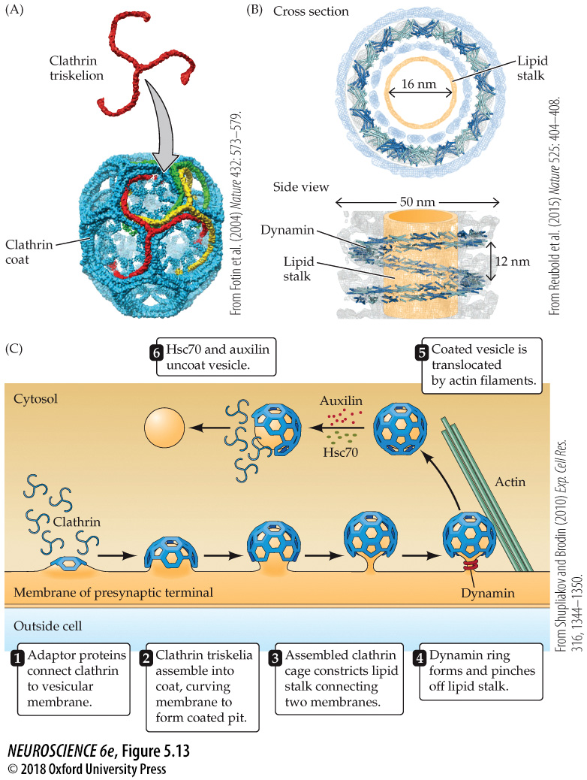
Molecular mechanisms of endocytosis following neurotransmitter release
Notes:
FIGURE 5.13 Molecular mechanisms of endocytosis following neurotransmitter release. (A) Individual clathrin triskelia assemble together to form membrane coats involved in membrane budding during endocytosis. (B) Dynamin forms ringlike coils around the lipid stalks of budding membranes; these rings disconnect vesicle membrane from plasma membrane during endocytosis. (C) A model for membrane budding during endocytosis. Following addition of synaptic vesicle membrane during exocytosis, clathrin triskelia attach to the vesicular membrane. Adaptor proteins, such as AP-2 and AP-180, aid their attachment. Polymerization of clathrin causes the membrane to curve and constrict, allowing dynamin to pinch off the coated vesicle. Subsequent uncoating of the vesicle, by Hsc70 and auxilin, yields a recycled synaptic vesicle. (A from Fotin et al., 2004; B from Ruebold et al., 2015; C after Shupliakov and Brodin, 2010.)

Slide 18
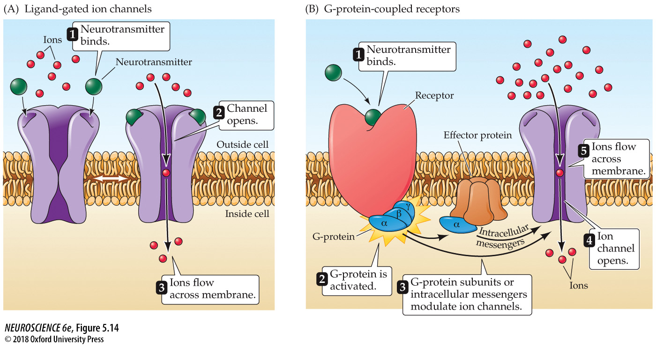
Two different types of neurotransmitter receptors
Notes:
FIGURE 5.14 Two different types of neurotransmitter receptors. (A) Ligand-gated ion channels combine receptor and channel functions in a single protein complex. (B) Metabotropic receptors usually activate G-proteins, which modulate ion channels directly or indirectly through intracellular effector enzymes and second messengers.

Slide 19
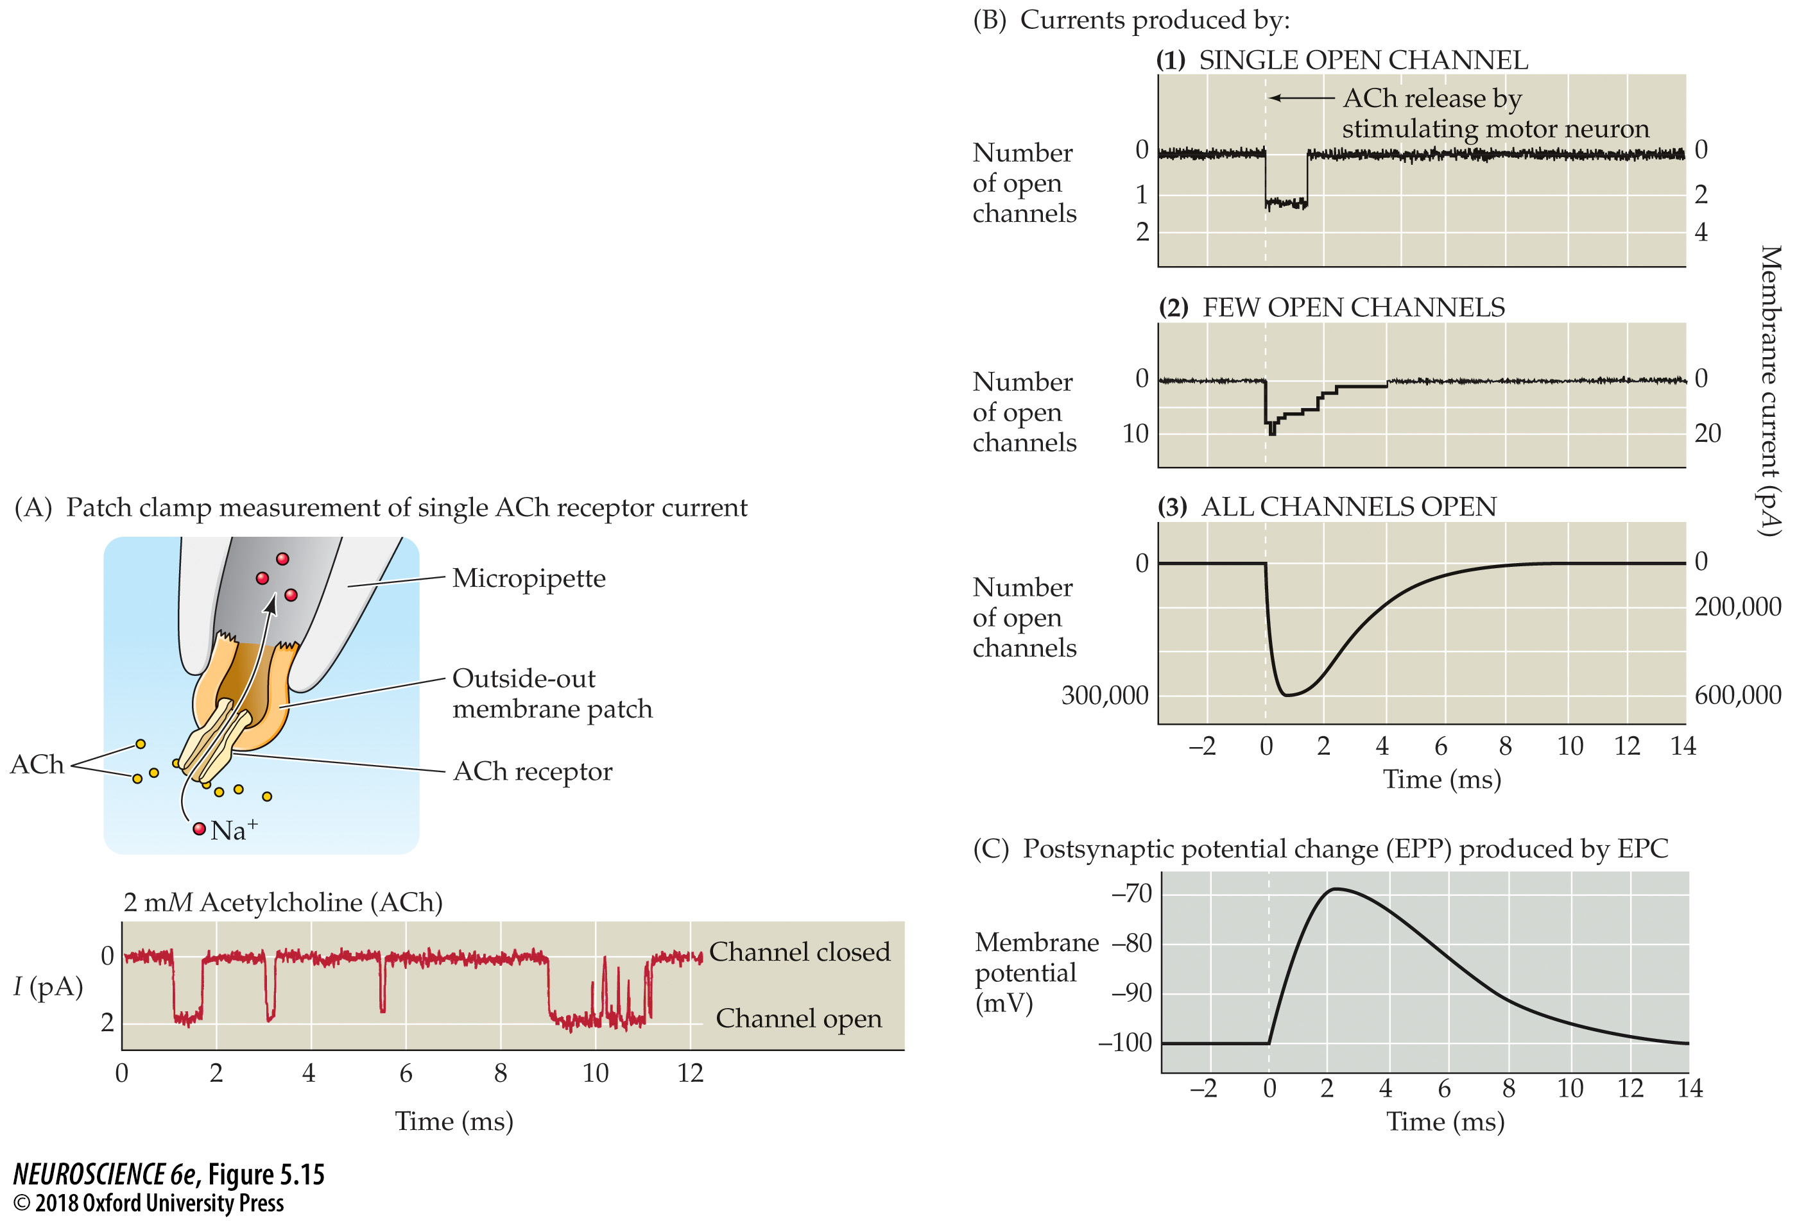
Activation of ACh receptors at neuromuscular synapses
Notes:
FIGURE 5.15 Activation of ACh receptors at neuromuscular synapses. (A) Patch clamp measurement of single ACh receptor currents from a patch of membrane removed from the postsynaptic muscle cell. When ACh is applied to the extracellular surface of the membrane, the repeated brief opening of a single channel can be observed as downward deflections corresponding to inward current (i.e., positive ions flowing into the cell). (B) Synchronized opening of many ACh-activated channels at a synapse being voltage clamped. (1) If a single channel is examined during the release of ACh from the presynaptic terminal, the channel can be seen to open transiently. (2) If several channels are examined together, ACh release opens the channels almost synchronously. (3) The opening of a very large number of postsynaptic channels produces a macroscopic EPC. (C) In a normal muscle cell (i.e., not being voltage clamped), the inward EPC depolarizes the postsynaptic muscle cell, giving rise to an EPP. Typically, this depolarization generates an action potential (not shown; see Figure 5.5B).

Slide 20
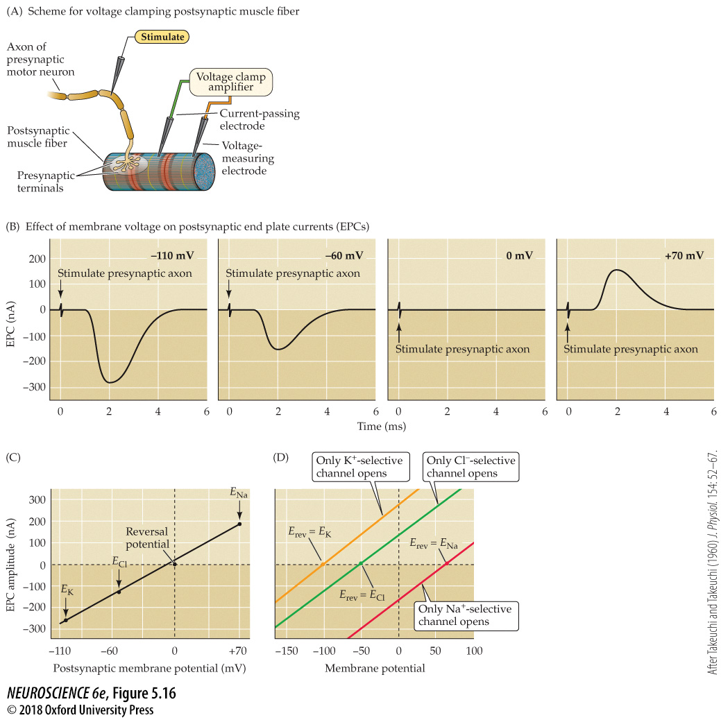
Influence of the postsynaptic membrane potential on end plate currents
Notes:
FIGURE 5.16 Influence of the postsynaptic membrane potential on end plate currents. (A) A postsynaptic muscle fiber is voltage clamped using two electrodes, while the presynaptic neuron is electrically stimulated to cause the release of ACh from presynaptic terminals. This experimental arrangement allows the recording of EPCs produced by ACh. (B) Amplitude and time course of EPCs generated by stimulating the presynaptic motor neuron while the postsynaptic cell is voltage clamped at four different membrane potentials. (C) The relationship between the peak amplitude of EPCs and postsynaptic membrane potential is nearly linear, with a reversal potential (the voltage at which the direction of the current changes from inward to outward) close to 0 mV. Also indicated on this graph are the equilibrium potentials of Na⁺, K⁺, and Cl– ions. (D) The identity of the ions permeating postsynaptic receptors is revealed by the reversal potential (E_{rev}). Activation of postsynaptic channels permeable only to K⁺ (yellow) results in currents reversing at E_{K}, near –100 mV, while activation of postsynaptic Na⁺ channels results in currents reversing at E_{Na}, near +70 mV (red). Cl–-selective currents reverse at E_{Cl}, near –50 mV (green). (A–C after Takeuchi and Takeuchi, 1960.)

Slide 21
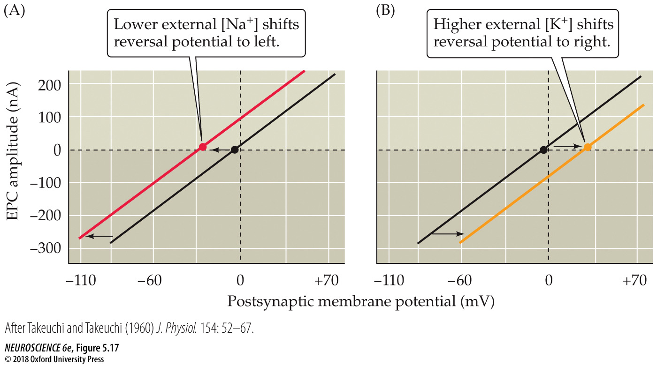
Reversal potential of the end plate current changes when ion gradients change
Notes:
FIGURE 5.17 Reversal potential of the end plate current changes when ion gradients change. (A) Lowering the external Na⁺ concentration causes EPCs to reverse at more negative potentials. (B) Raising the external K⁺ concentration makes the reversal potential more positive. (After Takeuchi and Takeuchi, 1960.)

Slide 22
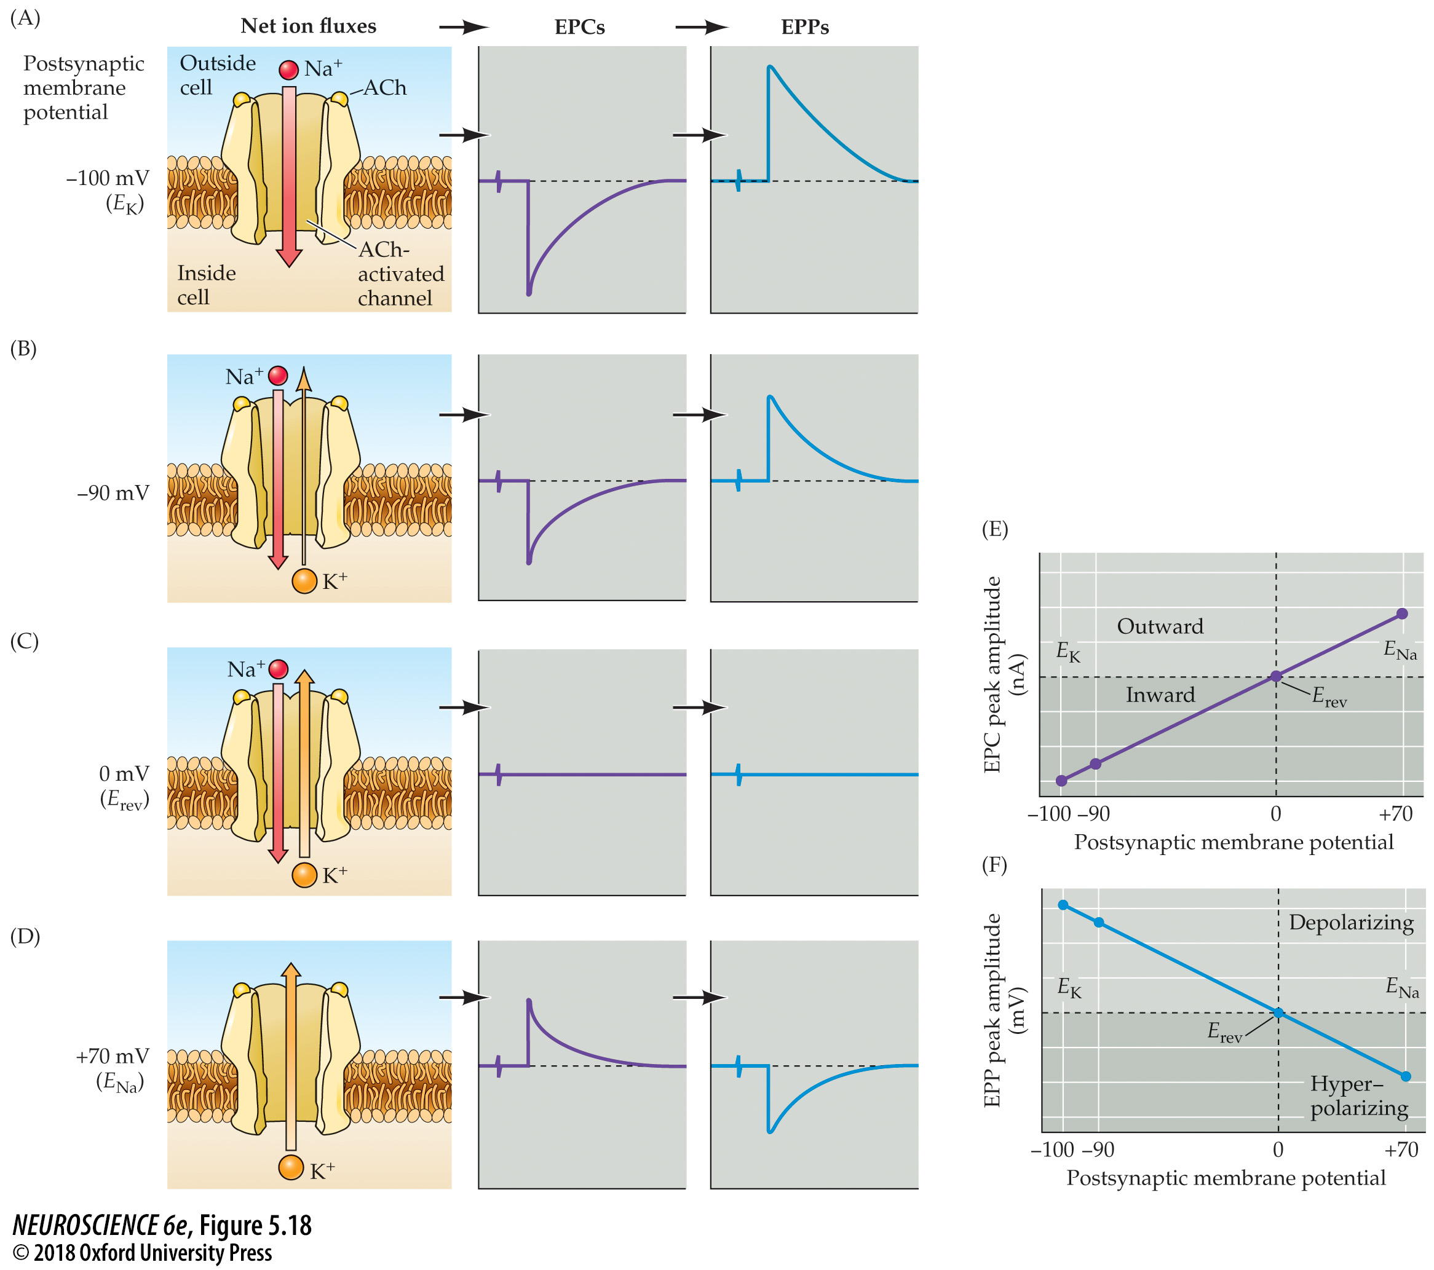
Na⁺ and K⁺ movements during EPCs and EPPs
Notes:
FIGURE 5.18 Na⁺ and K⁺ movements during EPCs and EPPs. (A–D) Each of the postsynaptic potentials indicated at the left results in different relative fluxes of Na⁺ and K⁺ (net ion fluxes). These ion fluxes determine the amplitude and polarity of the EPCs, which in turn determine the EPPs. Note that at about 0 mV the Na⁺ flux is exactly balanced by an opposite K⁺ flux, resulting in no net current flow, and hence no change in the membrane potential. (E) EPCs are inward at potentials more negative than E_{rev} and outward at potentials more positive than E_{rev}. (F) EPPs depolarize the postsynaptic cell at potentials more negative than E_{rev}. At potentials more positive than E_{rev}, EPPs hyperpolarize the cell.

Slide 23
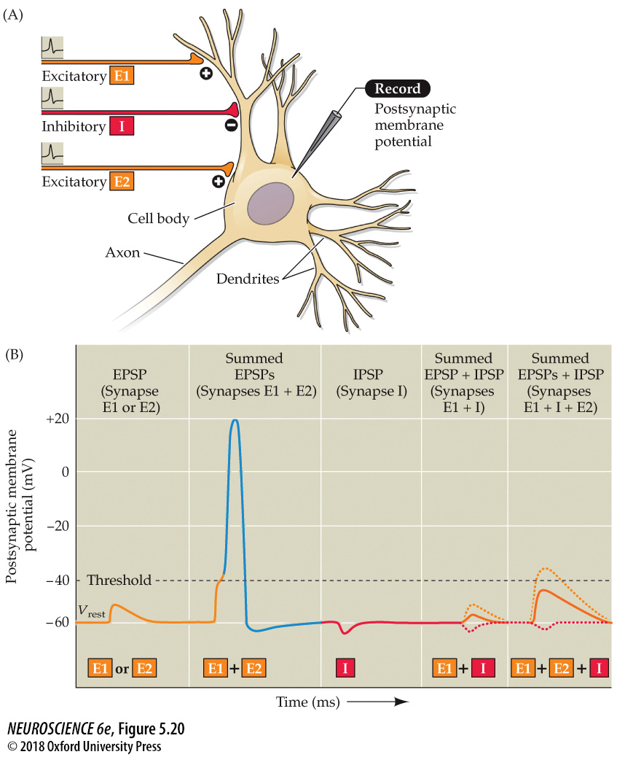
Summation of postsynaptic potentials
Notes:
FIGURE 5.20 Summation of postsynaptic potentials. (A) A microelectrode records the postsynaptic potentials produced by the activity of two excitatory synapses (E1 and E2) and an inhibitory synapse (I). (B) Electrical responses to synaptic activation. Stimulating either excitatory synapse (E1 or E2) produces a subthreshold EPSP, whereas stimulating both synapses at the same time (E1 + E2) produces a suprathreshold EPSP that evokes a postsynaptic action potential (shown in blue). Activation of the inhibitory synapse alone (I) results in a hyperpolarizing IPSP. Summing this IPSP (dashed red line) with the EPSP (dashed yellow line) produced by one excitatory synapse (E1 + I) reduces the amplitude of the EPSP (solid orange line), while summing it with the suprathreshold EPSP produced by activating synapses E1 and E2 keeps the postsynaptic neuron below threshold, so that no action potential is evoked.

Slide 24
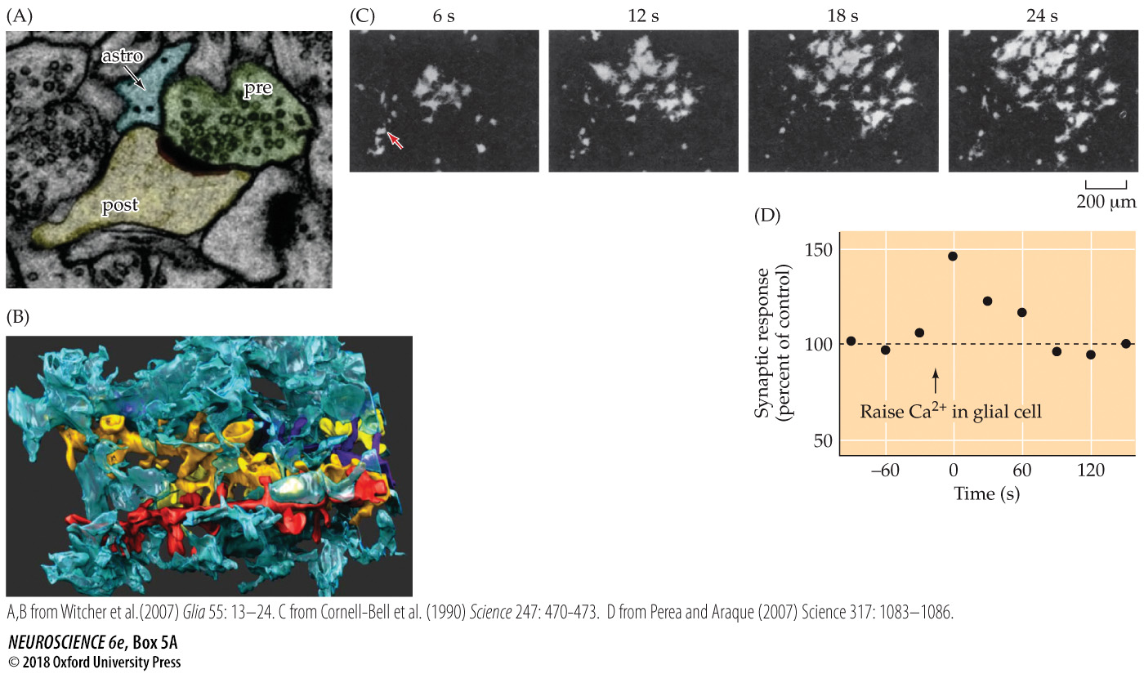
The Tripartite Synapse
Notes:
BOX 5A The Tripartite Synapse
(A) Electron microscopy image of a synapse between a presynaptic terminal (pre) and postsynaptic neuron (post), with a glial cell (astrocyte; astro) immediately adjacent to the synapse. (B) Three-dimensional structure of the contact between a glial cell (blue) surrounding dendrites of four postsynaptic neurons (different colors). (C) Application of glutamate (at arrow) increases intracellular Ca2+ (white) in cultured glia. Examination of these cells at different times indicates that the calcium signals spread as a wave through neighboring glia. (D) Transient elevation of Ca2+ within a single glial cell (arrow) enhances transmission at an excitatory synapse in the hippocampus. (A, B from Witcher et al., 2007; C from Cornell-Bell et al., 1990; D after Perea and Araque, 2007.)

Slide 25
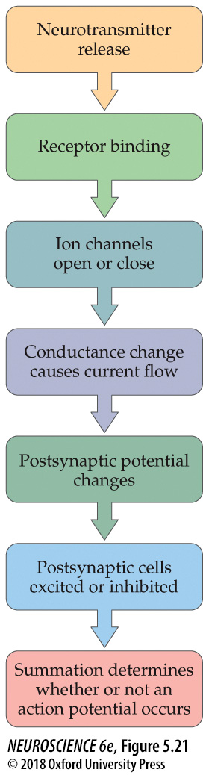
Overview of postsynaptic signaling
Notes:
FIGURE 5.21 Overview of postsynaptic signaling. Neurotransmitter released from presynaptic terminals binds to its cognate postsynaptic receptor, which causes the opening or closing of specific postsynaptic ion channels. The resulting conductance change causes current to flow, which may change the membrane potential. The postsynaptic cell sums (or integrates) all of the EPSPs and IPSPs, resulting in moment-to-moment control of action potential generation.

